Slide 1



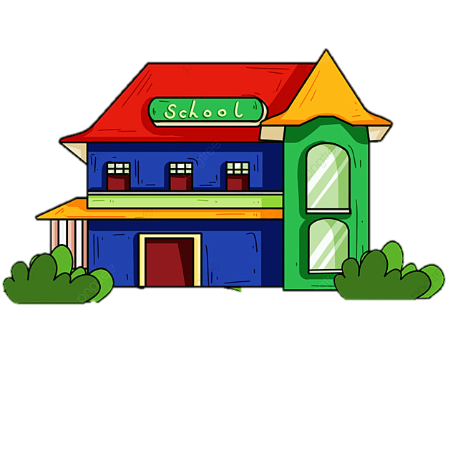



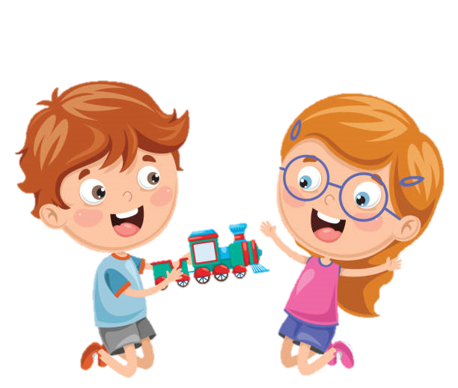





WELCOME TO OUR CLASS
CLASS: 3A8
TEACHER: MS.THAO
Notes:
Để nguyên trang bìa như này, chỉ thay đổi tên bài trong quá trình làm. Logo của sách Wonderful World

Slide 2
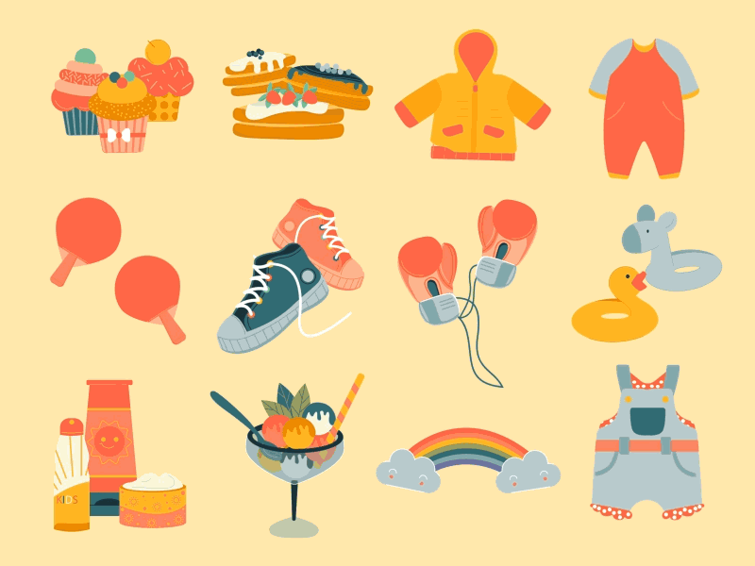

Unit 5
My Clothes
LESSON 1: Task 1,2,3

Slide 3

1 WARM UP

Slide 4
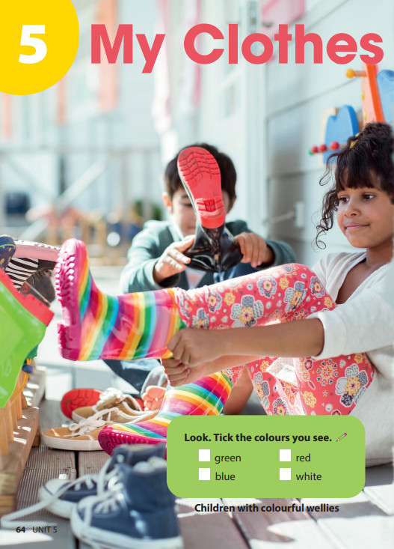
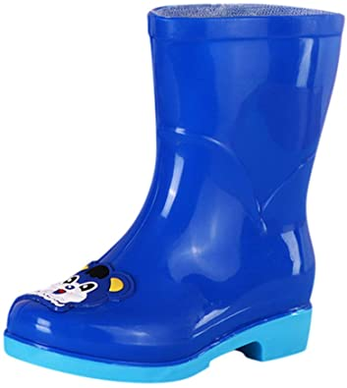
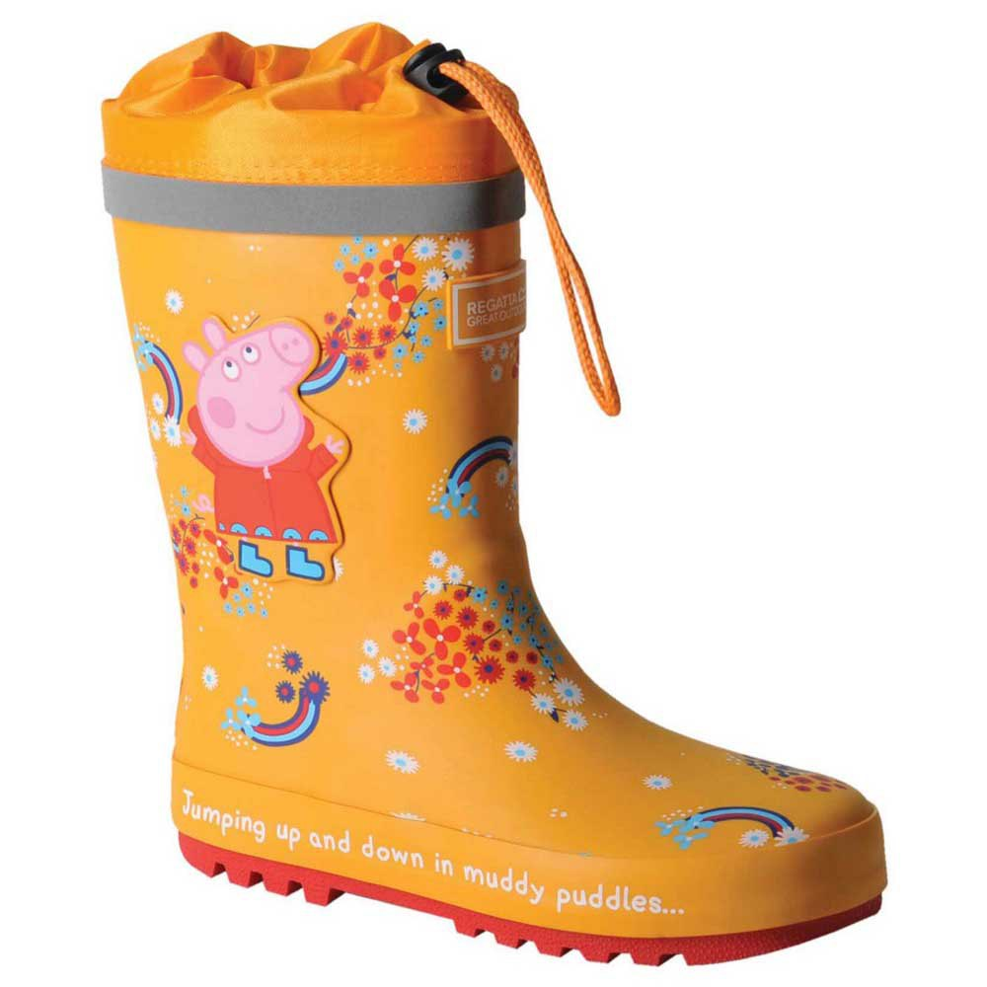
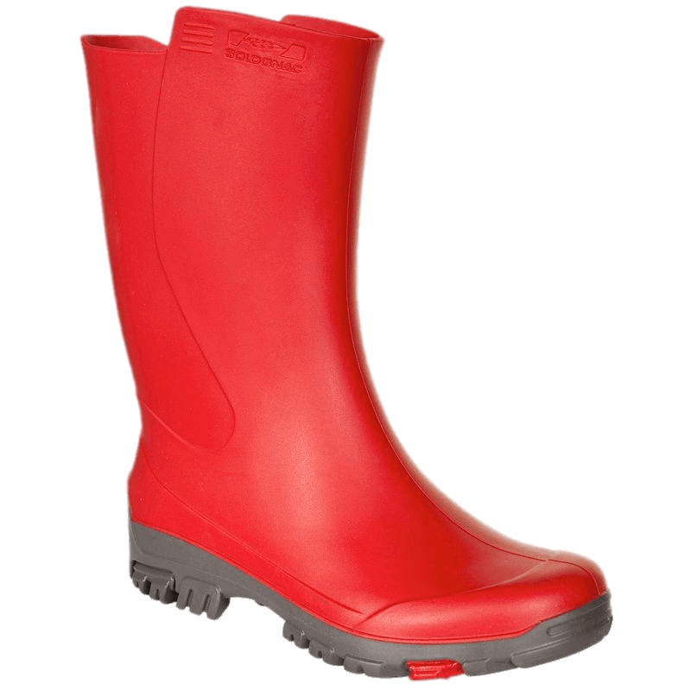
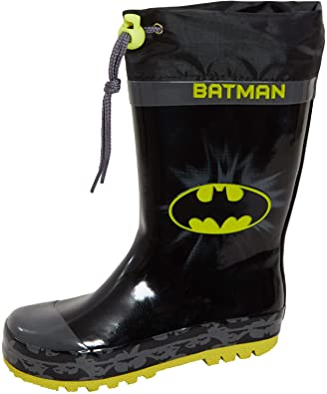
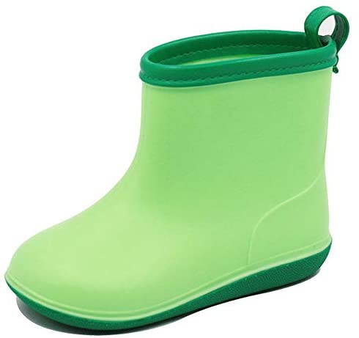
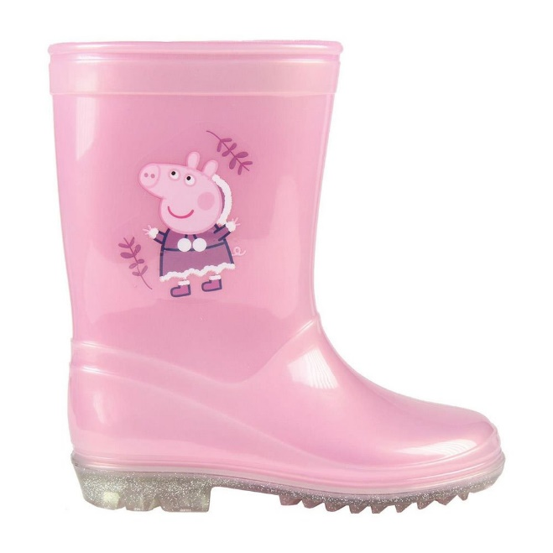
1
2
3
What colour is it?
What colour is it?
What colour is it?
4
5
6
What colour is it?
What colour is it?
What colour is it?

Slide 5


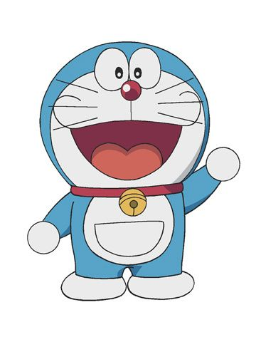
Hi! I’m Doraemon. I’m in Japan.
This is my magic bag.
What’s in my bag?

Slide 6
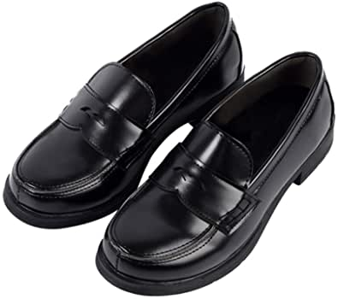
What’s in my bag?
shoes

Slide 7
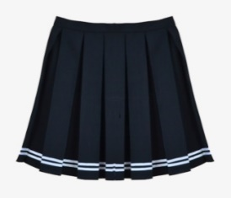
What’s in my bag?
skirt

Slide 8
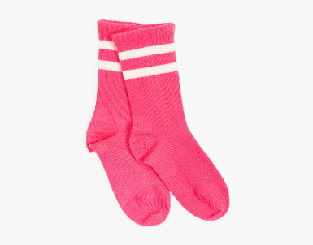
What’s in my bag?
socks

Slide 9
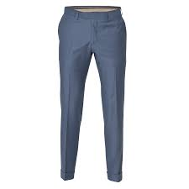
What’s in my bag?
trousers

Slide 10
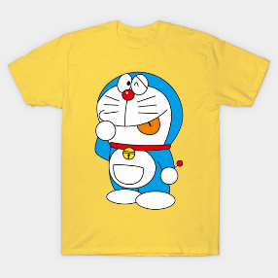
What’s in my bag?
T-shirt

Slide 11

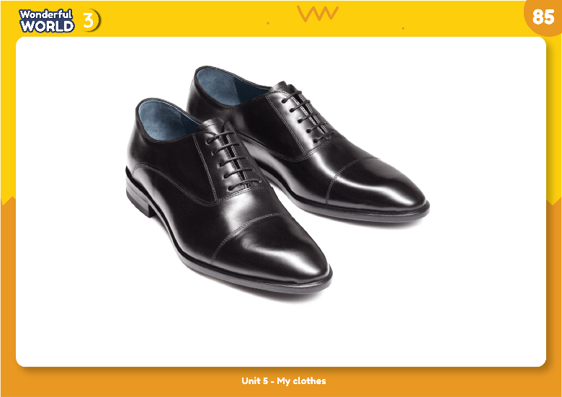
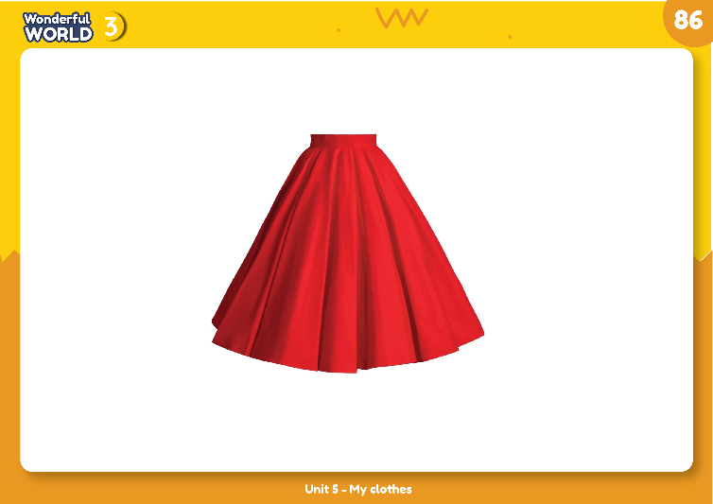
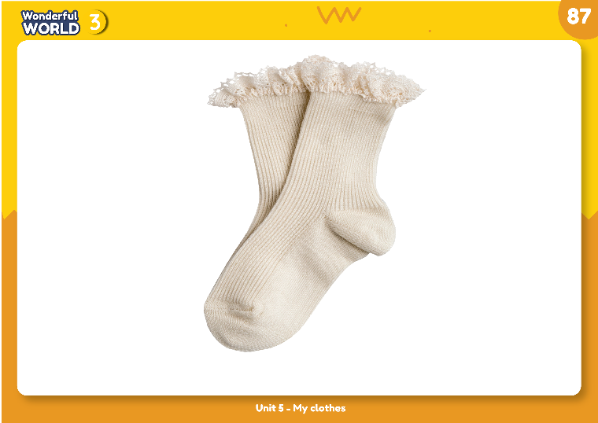
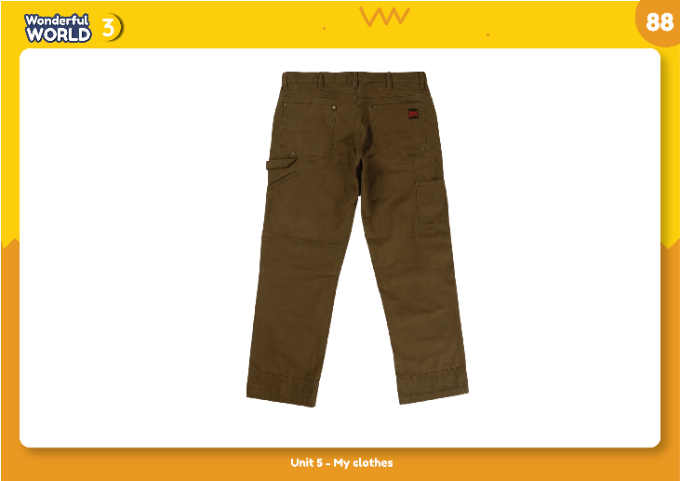
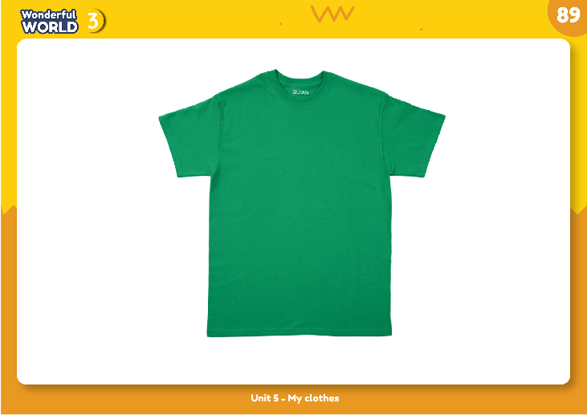
Listen and point. Repeat.
2 PRESENTATION
NEW WORDS

Slide 12

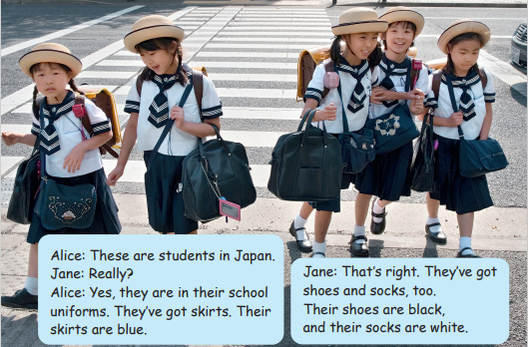
3 PRACTICE

Slide 13
Match:
a black
b white
c blue
1 skirt
2 shoes
3 socks

Slide 14

4 PRODUCTION
1. There are _______in their uniforms. They are ________
2. There aren’t _________ in their uniforms.
Say:
Skirt
Trousers
Shoes
Socks
T-shirt
✓
blue
X
✓
black
✓
white
X
There are skirts in their uniforms. They are blue.
There aren’t trousers in their uniforms.
There are shoes in their uniforms. They are black.
There are socks in their uniforms. They are white.
There aren’t T-shirt in their uniforms.

Slide 15
5 ASSESSMENT
1. Which topic do we learn today?
Clothes
2. How many words have we learn?
Five words: shoes, skirt, trousers, T-shirt
3. What activity do you like the most?
Notes:
THIẾT KẾ HOẠT ĐỘNG TƯƠNG TÁC CHO 3 CÂU HỎI NÀY. VỚI CÂU HỎI 3 LÀ TRẢ LỜI THEO Ý CỦA HS.

Slide 16

Goodbye Class💛!
THANK YOU FOR LISTENING!

