Slide 1




HOANG MAI EDUCATION & TRAINING DEPARTMENT
LINH NAM PRIMARY SCHOOL
WELCOME TO CLASS 5A8!
Teacher: Ngo Thi Binh

Slide 2
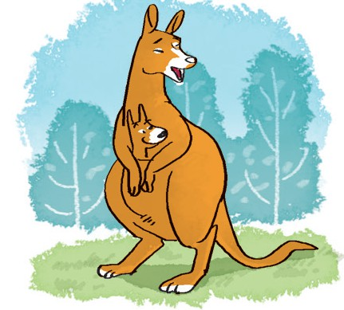
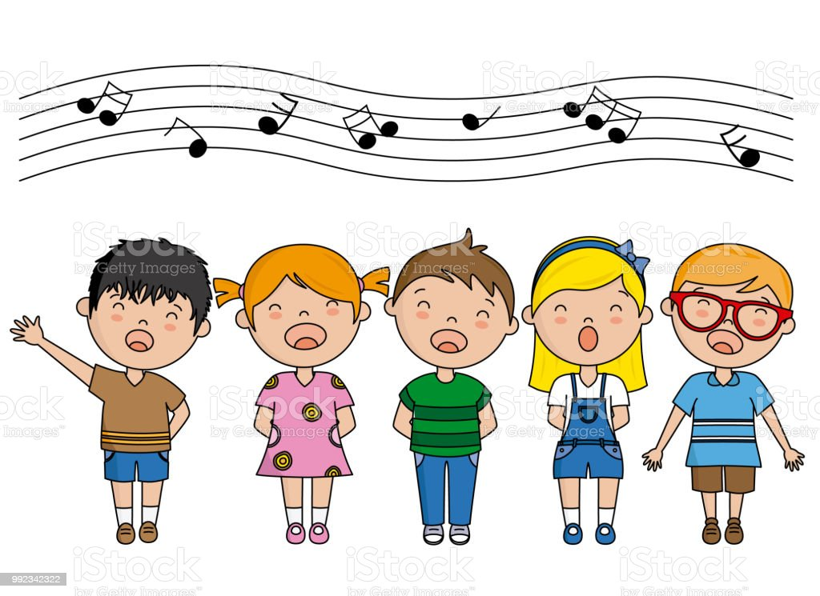

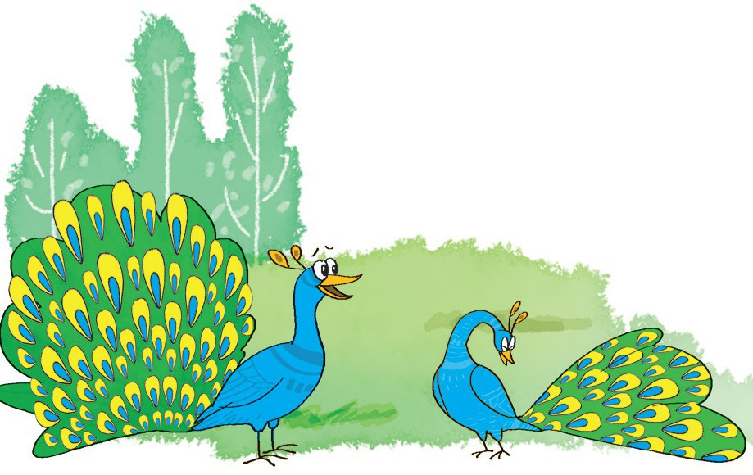
Let’s sing
Where did you go yesterday?
I went to the zoo.
Who did you go with?
I went with my friend Sue.
What did you see at the zoo?
We saw some peacocks.
They were very beautiful.
And we saw some kangaroos.
They were fast and funny, too.

Slide 3
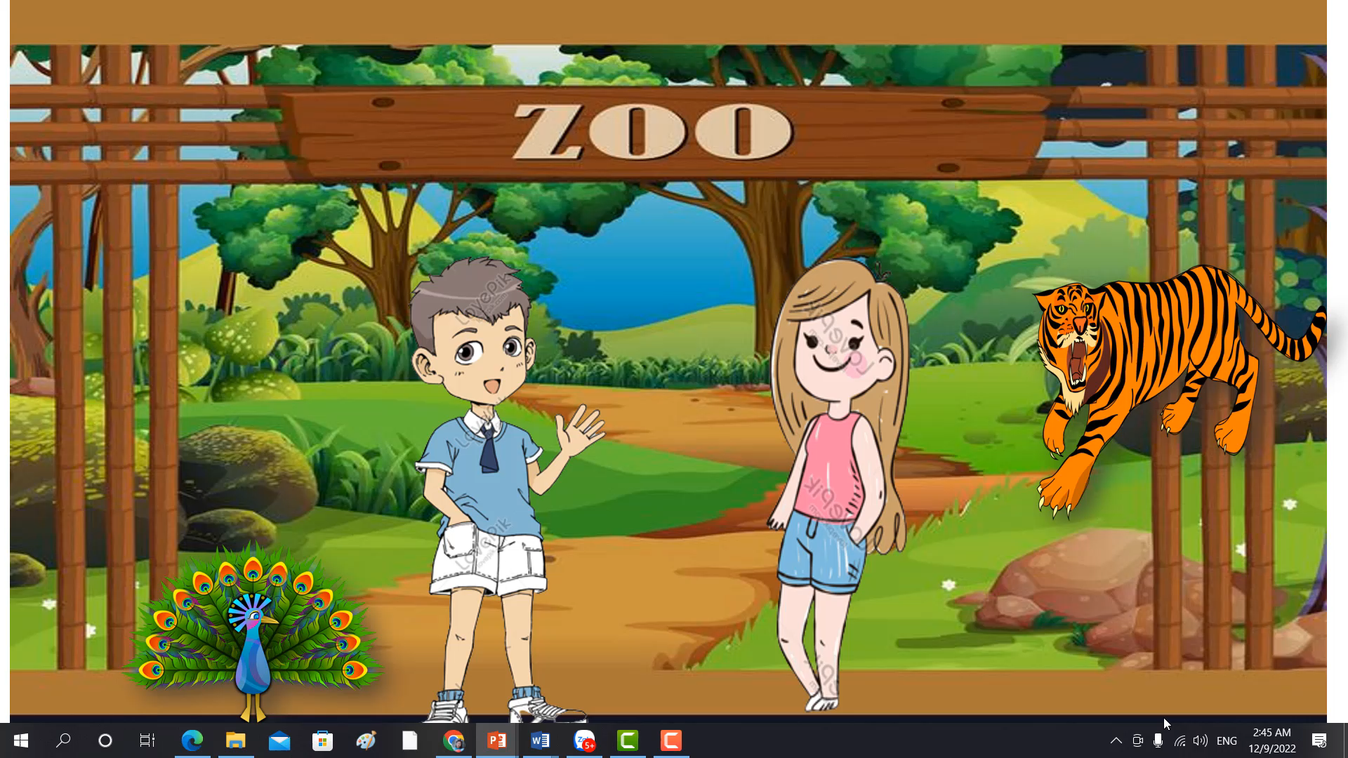
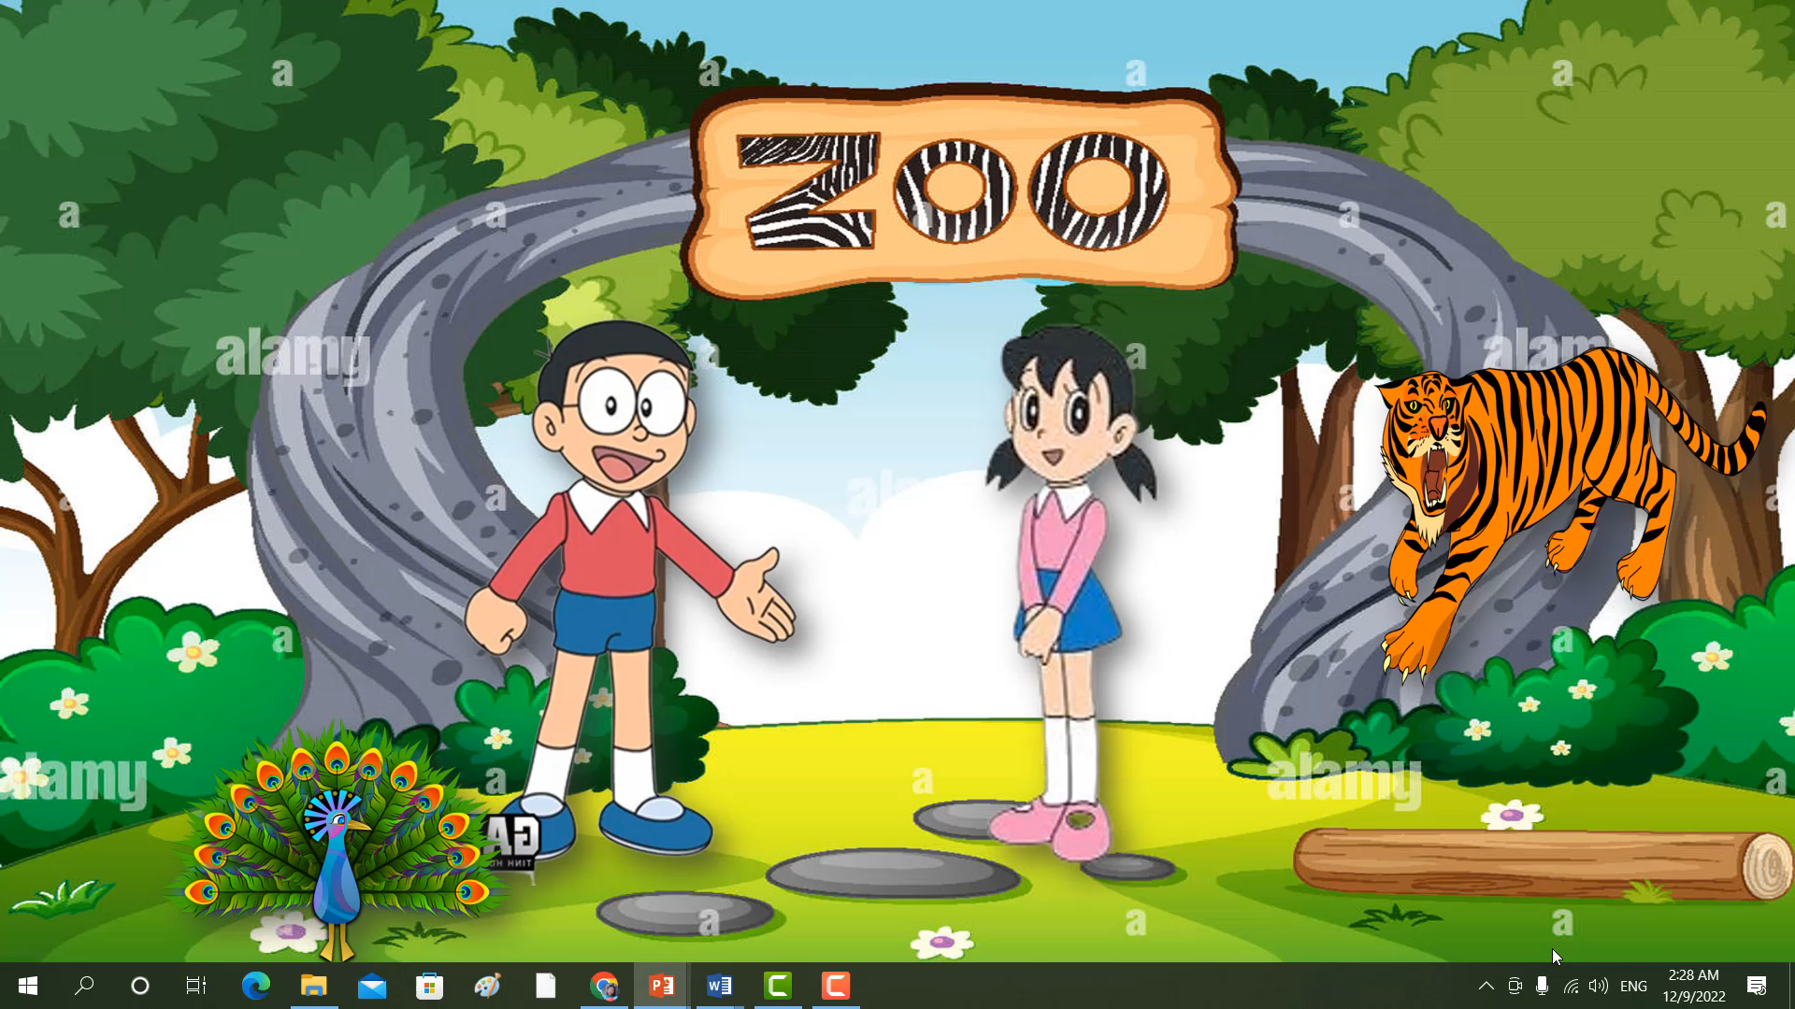
WARM UP
Dialogue 1
Dialogue 2

Slide 4

1.'When did you 'go to the 'zoo?
I 'went there 'yesterday.
2. 'What did the 'tigers 'do when you were 'there?
They 'roared 'loudly.

Slide 5

1. What did you see at the zoo?
I saw lots of animals.
2. What did the peacocks do when you were there?
They moved beautifully.

Slide 6


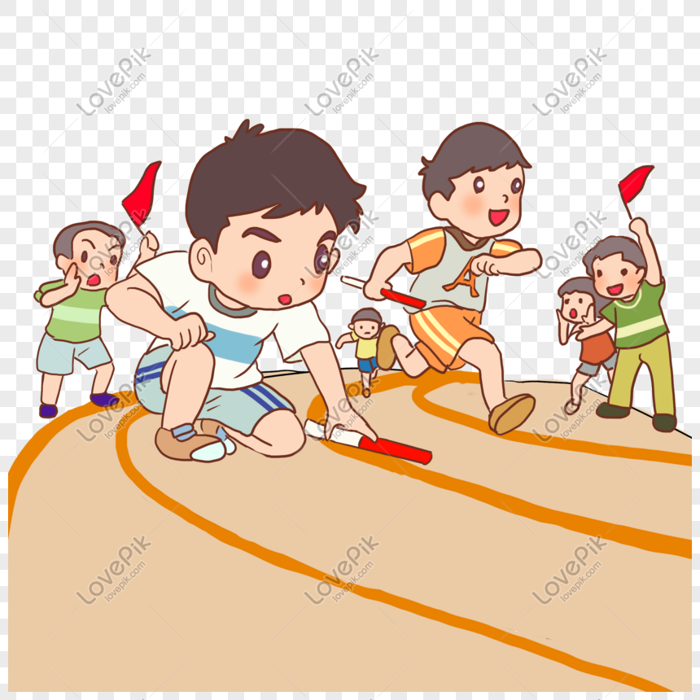
TEAM GAME
There are 2 teams playing. Each team has 4 members.
Each member will underline stressed words in one sentence.
The team underlines the stressed words correctly and quickly will be the winner.
Wave your flag when you finish.

Slide 7
TEAM GAME
There are 2 teams playing. Each team has 4 members.
Each member will underline stresed words in one sentence.
The team underlines the stressed words correctly and quickly will be the winner.
Wave your flag when you finish.

Slide 8
TEAM GAME
I saw lots of animals.
1. What did you see at the zoo?
I saw lots of animals.
1. What did you see at the zoo?
2. What did the peacocks do when you were there?
2. What did the peacocks do when you were there?
They moved beautifully.
They moved beautifully.

Slide 9
1
1.What did you see at the zoo?
I saw lots of animals.
2.What did the peacocks do
when you were there?
They moved beautifully.
2

Slide 10
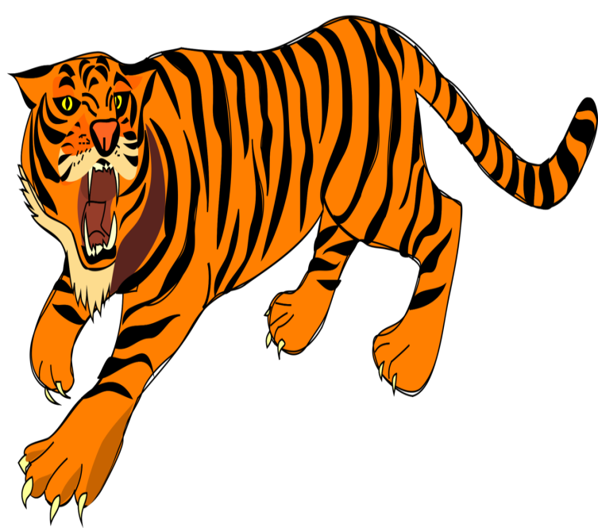
1.What did you see at the zoo?
I saw lots of animals.
2.What did the do
when you were there?
2.What did the peacocks do
when you were there?
They moved beautifully.
They .
roared loudly

Slide 11
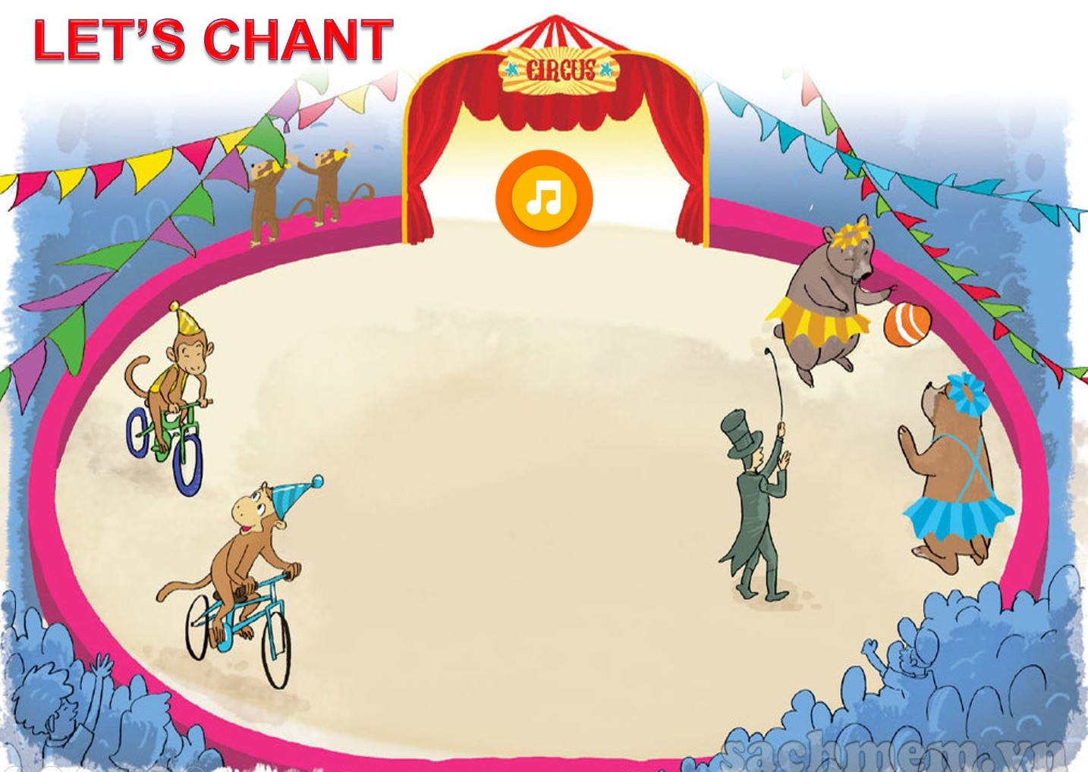

Slide 12
AT THE CIRCUS
What did you do yesterday?
I went to the circus.
I had a lot of fun.
What did you see?
I saw the animals.
They were playing games.
What did they do?
The monkeys rode bicycles.
The bears played volleyball.
How did the monkeys ride bicycles?
They rode them quickly.

Slide 13
AT THE CIRCUS
1.2.3.4
What did you do yesterday?
I went to the circus.
I had a lot of fun.
What did you see?
I saw the animals.
They were playing games.
What did they do?
The monkeys rode bicycles.
The bears played volleyball.
How did the monkeys / ride bicycles?
They rode them quickly.

Slide 14
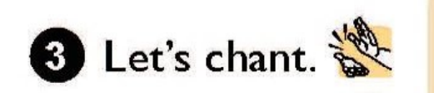
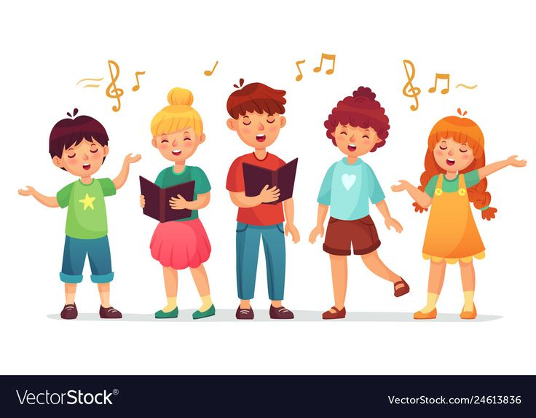
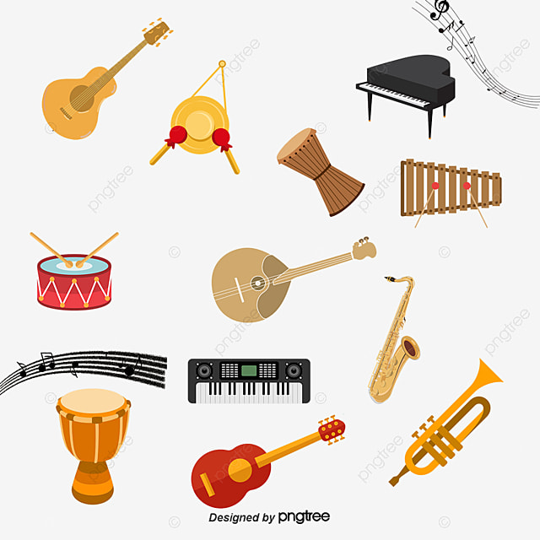

Slide 15
* CREATE A NEW CHANT
What did you do yesterday?/
(……………..)
I went to the circus.
(…………….)
I had a lot of fun.
What did you see?
I saw the animals.
They were playing games.
(…………………)

Slide 16
GOODBYE!
Best wishes for you!

